Slide 1
Security Pitfalls for Workload Identities in Azure

Slide 2

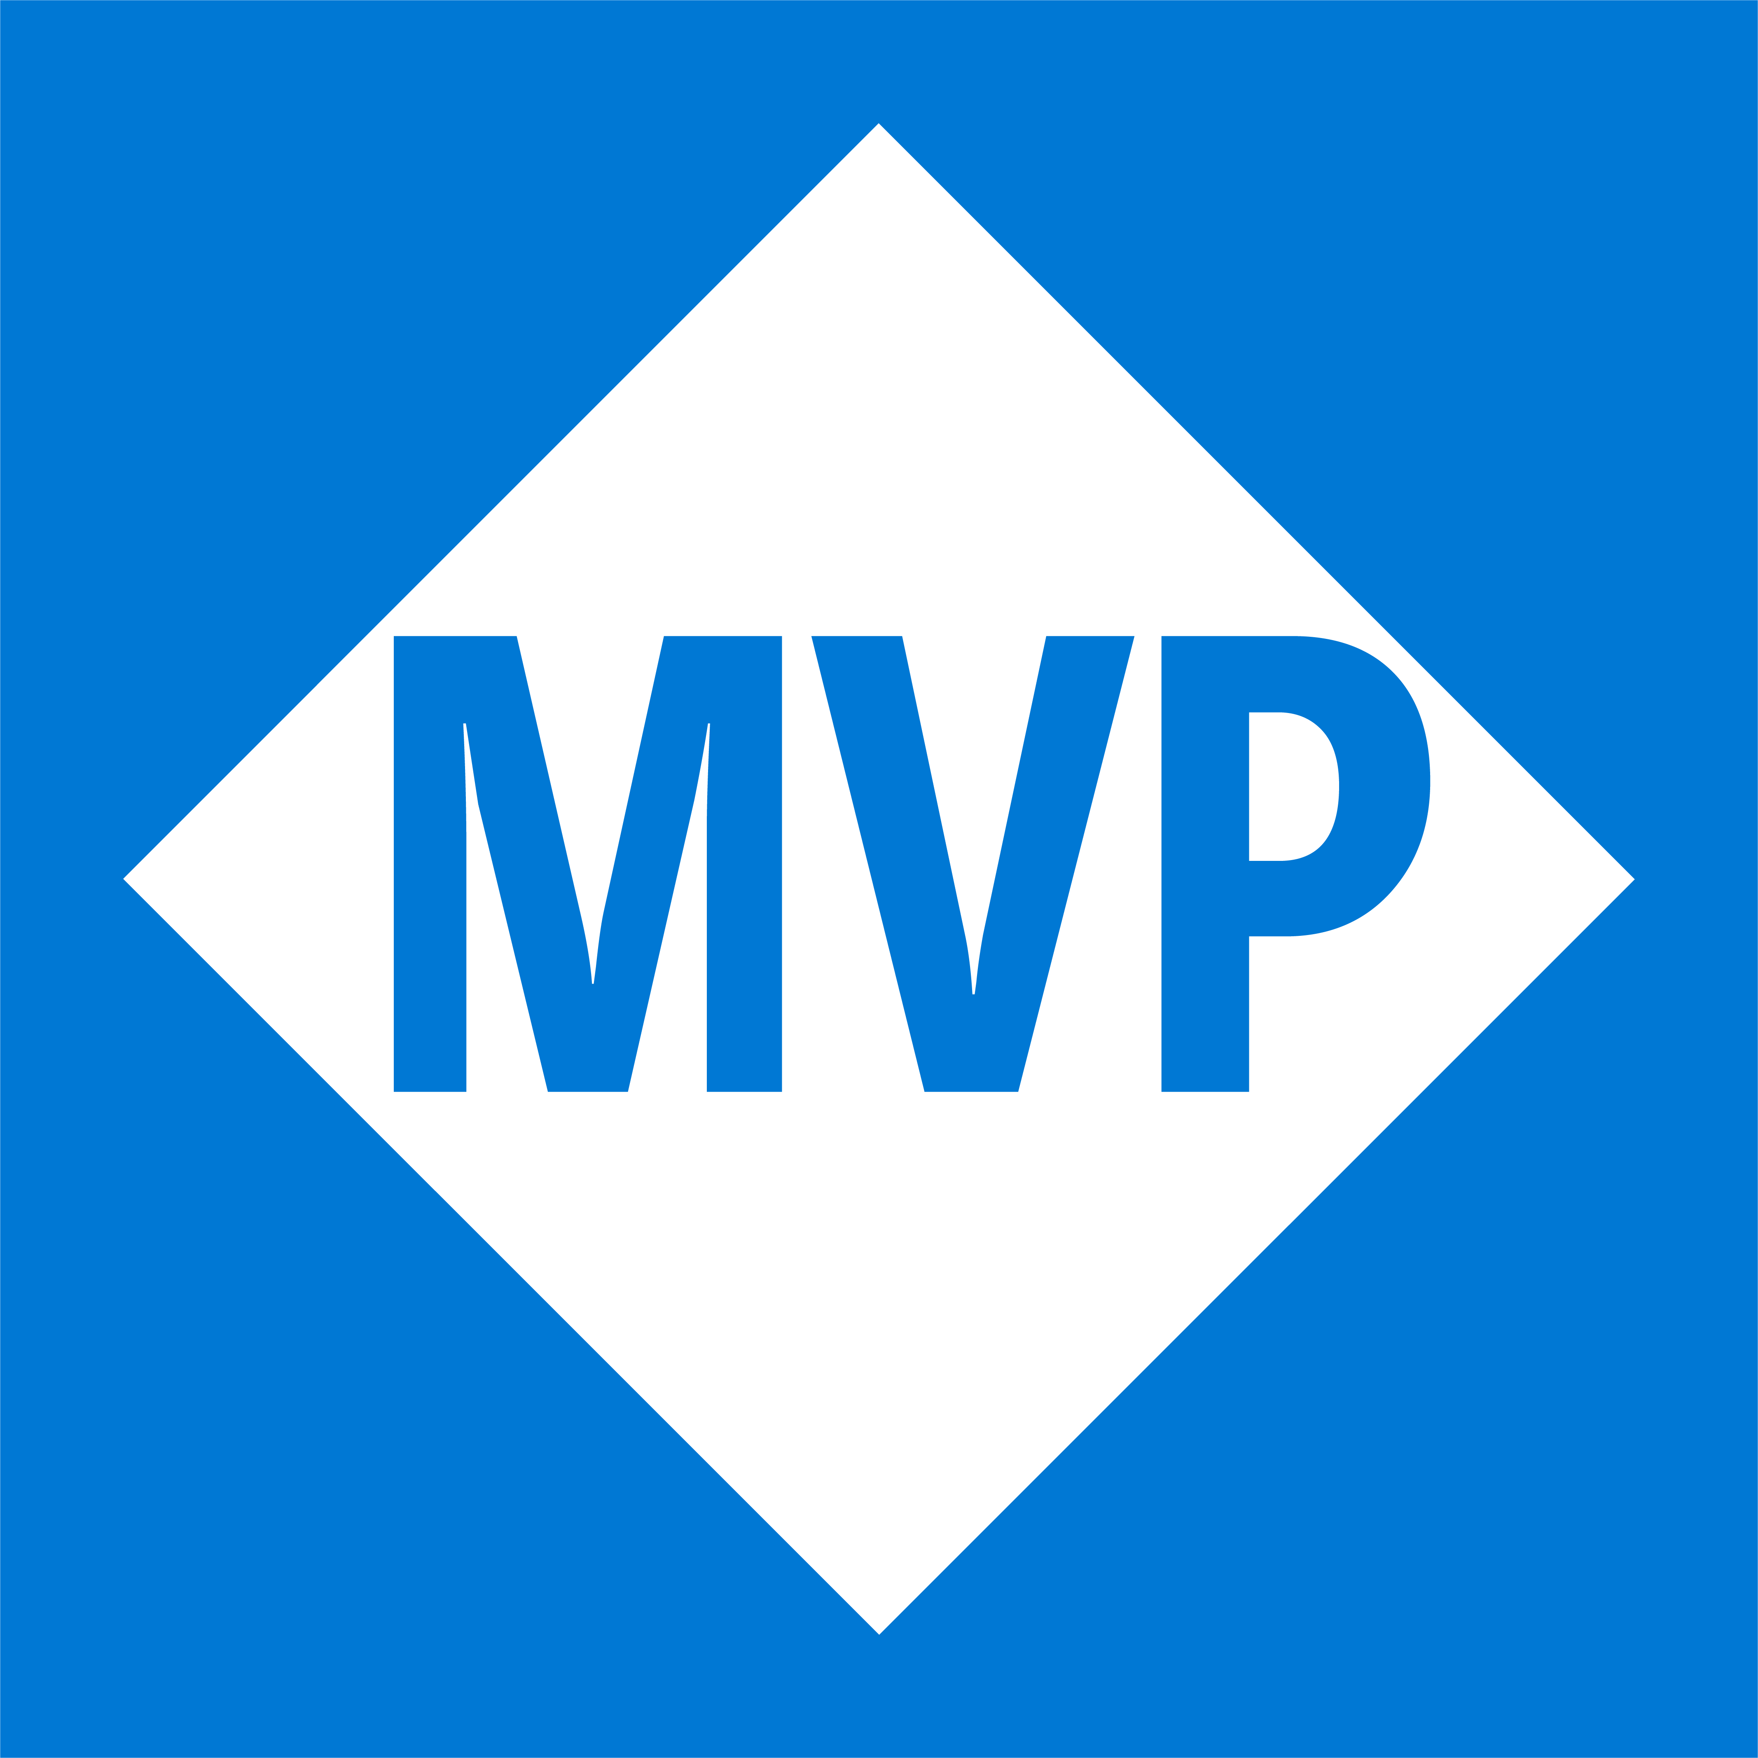
Emanuel Palm
@PalmEmanuel
🧙☕🍰🧗🥏
💙 Everything-as-Code
📦 Makes modules & tools
📃 Fan of Open Source
☁️ Blogs at pipe.how

Slide 3
Session Overview
Graphics with arrows between each block of the session
Workload Identity Types
Security pitfalls
Summary
Questions

Slide 4
Security Pitfalls list
Principle of least privilege
Using Client Secrets
Credential Management (if we really need them, use secret storage like KV)! Rotate credentials often
User-Assigned Managed Identities (unintentional assigning & Azure Policy works for them!)
Shared identities between services
Not using Workload ID (Conditional Access – IP ranges (if the identity should only be used from on-prem, limit it, if it should only be used from west europe Microsoft-hosted agents in Azure DevOps, limit it etc) & Risky sign-ins)
No clear life cycle process for all types (if we have clear on&offboarding for users, why would we allow these potentially less secure identities to be without?)
Access reviews
Securing the entire supply chain and pipeline (doesn’t matter if the identity can only be used from a pipeline if that pipeline isn’t locked down too, and no one can override branch policies etc)
Monitoring sign-ins and logs for anomalies
Too long access token lifetime policies (use proper refresh flows instead)
Not restricting who has access to use the workload identities
Not ensuring traceability (if I have access to of credentials as the app, it shouldn’t be possible for me to use it without my name showing (malicious insider))

Slide 5
Notes
A slide talking about MFA and PIM, and how we don’t have the option of that level of security for workload identities – we need to be restrictive with what access we give to non-personal accounts.
Workload Identity Types
Service Principals
Talk about the 3 types of Credentials

Slide 6
We’re
not
talking about
users

Slide 7
We’re
talking about
Unmanaged Identities

Slide 8




Passwords & Passwordless
Trusted Location & Conditional Access
Trusted Devices & Authenticators
Sign-in Logs & Risk Policies
Notes:
When talking about authentication, we always talk about these things. But not…

Slide 9
“We have too many Service Principals”
Notes:
That’s not true, you can actually have up to 500 000 objects in Entra, and even more if you ask Microsoft nicely.

Slide 10
Identity Types
Workload
“A collection of application resources, data, and supporting infrastructure that function together towards a defined business goal.”
- Microsoft Azure Well-Architected Framework

Slide 11
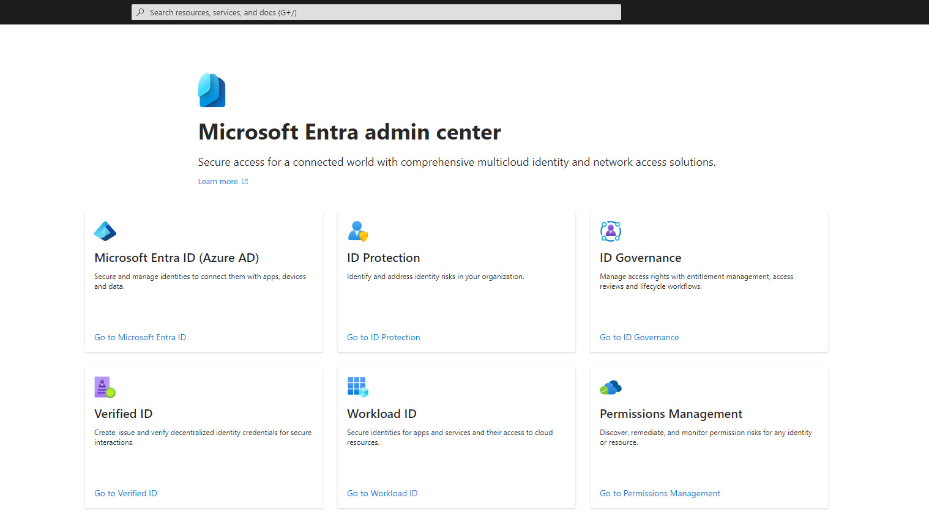
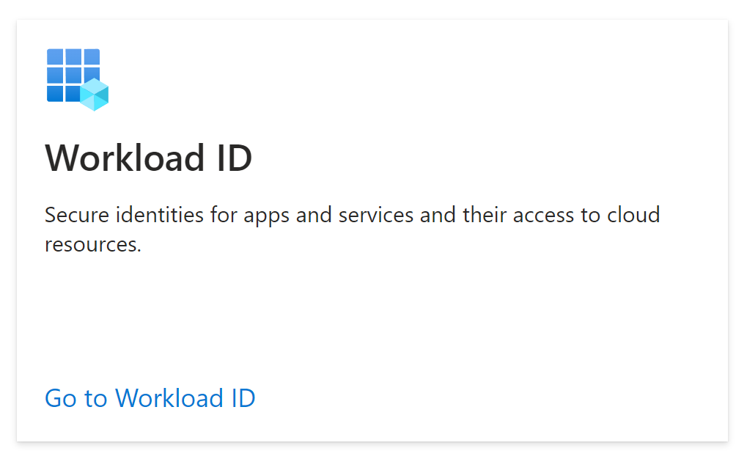

Slide 13



Thank you!
Questions?
pipe.how
@PalmEmanuel

